Slide 1
Object-Oriented and
Classical Software Engineering
8th Edition, WCB/McGraw-Hill, 2010
Stephen R. Schach srs@vuse.vanderbilt.edu

Slide 2
CHAPTER 15
POSTDELIVERY MAINTENANCE

Slide 3
Overview
Why postdelivery maintenance is necessary
What is required of postdelivery maintenance programmers?
Postdelivery maintenance mini case study
Management of postdelivery maintenance
Maintenance of object-oriented software
Postdelivery maintenance skills versus development skills
Reverse engineering
Testing during postdelivery maintenance

Slide 4
Overview (contd)
CASE tools for postdelivery maintenance
Metrics for postdelivery maintenance
Postdelivery maintenance: The MSG Foundation case study
Challenges of postdelivery maintenance

Slide 5
Postdelivery Maintenance
Postdelivery maintenance
  Any change to any component of the product (including documentation) after it has passed the acceptance test
This is a short chapter
  But the whole book is essentially on postdelivery maintenance
In this chapter we explain how to ensure that maintainability is not compromised during postdelivery maintenance

Slide 6
15.1 Why Postdelivery Maintenance Is Necessary
Corrective maintenance
  To correct residual faults
    Analysis, design, implementation, documentation, or any other type of faults

Slide 7
Why Postdelivery Maint. Is Necessary (contd)
Perfective maintenance
  Client requests changes to improve product effectiveness
    Add additional functionality
    Make product run faster
    Improve maintainability

Slide 8
Why Postdelivery Maint. Is Necessary (contd)
Adaptive maintenance
  Responses to changes in the environment in which the product operates
    The product is ported to a new compiler, operating system, and/or hardware
    A change to the tax code
    9-digit ZIP codes

Slide 9
15.2 What Is Required of Postdelivery Maintenance Programmers?
At least 67% of the total cost of a product accrues during postdelivery maintenance
Maintenance is a major income source
Nevertheless, even today many organizations assign maintenance to
  Unsupervised beginners, and
  Less competent programmers

Slide 10
What is Required of Postd. Maint. Prog. (contd)?
Postdelivery maintenance is one of the most difficult aspects of software production because
  Postdelivery maintenance incorporates aspects of all other workflows

Slide 11
What is Required of Postd. Maint. Prog. (contd)?
Suppose a defect report is handed to a maintenance programmer
  Recall that a “defect” is a generic term for a fault, failure, or error
What is the cause?
  Nothing may be wrong
  The user manual may be wrong, not the code
  Usually, however, there is a fault in the code

Slide 12
Corrective Maintenance
What tools does the maintenance programmer have to find the fault?
  The defect report filed by user
  The source code
  And often nothing else

Slide 13
Corrective Maintenance (contd)?
A maintenance programmer must therefore have superb debugging skills
  The fault could lie anywhere within the product
  The original cause of the fault might lie in the by now non-existent specifications or design documents

Slide 14
Corrective Maintenance
Suppose that the maintenance programmer has located the fault
Problem:
  How to fix it without introducing a regression fault

Slide 15
Corrective Maintenance (contd)
How to minimize regression faults
  Consult the detailed documentation for the product as a whole
  Consult the detailed documentation for each individual module
What usually happens
  There is no documentation at all, or
  The documentation is incomplete, or
  The documentation is faulty

Slide 16
Corrective Maintenance (contd)
The programmer must deduce from the source code itself all the information needed to avoid introducing a regression fault
The programmer now changes the source code

Slide 17
The Programmer Now Must
Test that the modification works correctly
  Using specially constructed test cases
Check for regression faults
  Using stored test data
Add the specially constructed test cases to the stored test data for future regression testing
Document all changes

Slide 18
Corrective Maintenance (contd)
Major skills are required for corrective maintenance
  Superb diagnostic skills
  Superb testing skills
  Superb documentation skills

Slide 19
Adaptive and Perfective Maintenance
The maintenance programmer must go through the
  Requirements
  Specifications
  Design
  Implementation and integration
workflows, using the existing product as a starting point

Slide 20
Adaptive and Perfective Maintenance (contd)
When programs are developed
  Specifications are produced by analysis experts
  Designs are produced by design experts
  Code is produced by programming experts
But a maintenance programmer must be expert in all three areas, and also in
  Testing, and
  Documentation

Slide 21
Conclusion
No form of maintenance
  Is a task for an unsupervised beginner, or
  Should be done by a less skilled computer professional

Slide 22
The Rewards of Maintenance
Maintenance is a thankless task in every way
  Maintainers deal with dissatisfied users
  If the user were happy, the product would not need maintenance
  The user’s problems are often caused by the individuals who developed the product, not the maintainer
  The code itself may be badly written
  Postdelivery maintenance is despised by many software developers
  Unless good maintenance service is provided, the client will take future development business elsewhere
  Postdelivery maintenance is the most challenging aspect of software production — and the most thankless

Slide 23
The Rewards of Maintenance (contd)
How can this situation be changed?
Managers must assign maintenance to their best programmers, and
Pay them accordingly

Slide 24
15.3 Postdelivery Maintenance Mini Case Study
The Temperate Fruit Committee orders software to be developed for exactly 7 temperate fruits
  Apples, apricots, cherries, nectarines, peaches, pears, and plums
It is extended to include kiwi fruit, with difficulty
The product now needs to handle 26 additional fruits
“Just to the same thing 26 times”

Slide 25
Postdelivery Maintenance Case Study (contd)
Lessons to be learnt from this
  The problem was caused by the developer, not the maintainer
  A maintainer is often responsible for fixing other people’s mistakes
  The client frequently does not understand that postdelivery maintenance can be difficult, or all but impossible
  This is exacerbated when previous apparently similar perfective and adaptive maintenance tasks have been carried out
  All software development activities must be performed with an eye on future postdelivery maintenance

Slide 26
15.4 Management of Postdelivery Maintenance
Various issues regarding management of postdelivery maintenance are now considered

Slide 27
15.4 .1 Defect Reports
We need a mechanism for changing a product
If the product appears to function incorrectly, the user files a defect report
  It must include enough information to enable the maintenance programmer to recreate the problem
Ideally, every defect should be fixed immediately
  In practice, an immediate preliminary investigation is the best we can do

Slide 28
Management of Postdelivery Mainten. (contd)
The maintenance programmer should first consult the defect report file
It contains
  All reported defects not yet fixed, and
  Suggestions for working around them

Slide 29
If the Defect Has Been Previously Reported
Give the information in the defect report file to the user

Slide 30
If it Is a New Defect
The maintenance programmer should try to find
  The cause,
  A way to fix it, and
  A way to work around the problem
The new defect is now filed in the defect report file, together with supporting documentation
  Listings
  Designs
  Manuals

Slide 31
If it Is a New Defect (contd)
The file should also contain the client’s requests for perfective and adaptive maintenance
  The contents of the file must be prioritized by the client
  The next modification is the one with the highest priority
Copies of defect reports must be circulated to all
  Including: An estimate of when the defect can be fixed
If the same failure occurs at another site, the user can determine
  If it is possible to work around the defect, and
  How long until it can be fixed

Slide 32
Management of Postdelivery Mainten. (contd)
In an ideal world
  We fix every defect immediately
  Then we distribute the new version of the product to all the sites
In the real world
  We distribute defect reports to all sites
  We do not have the staff for instant maintenance
  It is cheaper to make a number of changes at the same time, particularly if there are multiple sites

Slide 33
15.4.2 Authorizing Changes to the Product
Corrective maintenance
  Assign a maintenance programmer to determine the fault and its cause, then repair it
  Test the fix, test the product as a whole (regression testing)
  Update the documentation to reflect the changes made
  Update the prologue comments to reflect
    What was changed,
    Why it was changed,
    By whom, and
    When

Slide 34
Authorizing Changes to the Product (contd)
Adaptive and perfective maintenance
  As with corrective maintenance, except there is no defect report
  There is a change in requirements instead

Slide 35
Authorizing Changes to the Product (contd)
What if the programmer has not tested the fix adequately?
  Before the product is distributed, it must be tested by the SQA group
Postdelivery maintenance is extremely hard
Testing is difficult and time consuming
  Performed by the SQA group

Slide 36
Authorizing Changes to the Product (contd)
The technique of baselines and private copies must be followed
The programmer makes changes to private copies of code artifacts, tests them
The programmer freezes the previous version, and gives the modified version to SQA to test
SQA performs tests on the current baseline version of all code artifacts

Slide 37
15.4.3 Ensuring Maintainability
Maintenance is not a one-time effort
We must plan for maintenance over the entire life cycle
  Design workflow — use information-hiding techniques
  Implementation workflow — select variable names meaningful to future maintenance programmers
  Documentation must be complete and correct, and reflect the current version of every artifact

Slide 38
Ensuring Maintainability (contd)
During postdelivery maintenance, maintainability must not be compromised
  Always be conscious of the inevitable further maintenance
Principles leading to maintainability are equally applicable to postdelivery maintenance itself

Slide 39
15.4.4 The Problem of Repeated Maintenance
The moving target problem is frustrating to the development team
Frequent changes have an adverse effect on the maintainability of the product

Slide 40
The Moving Target Problem
The problem is exacerbated during postdelivery maintenance
The more changes there are
  The more the product deviates from its original design
  The more difficult further changes become
  Documentation becomes even less reliable than usual
  Regression testing files are not up to date
  A total rewrite may be needed for further maintenance

Slide 41
The Moving Target Problem (contd)
Apparent solution
  Freeze the specifications once they have been signed off until delivery of the product
  After each request for perfective maintenance, freeze the specifications for (say) 3 months or 1 year
In practice
  The client can order changes the next day
  If willing to pay the price, the client can order changes on a daily basis
“He who pays the piper calls the tune”

Slide 42
Warning
It is no use implementing changes slowly
The relevant personnel are replaced
Nothing can be done if the person calling for repeated change has sufficient clout

Slide 43
15.5 Maintenance of Object-Oriented Software
The object-oriented paradigm apparently promotes maintenance in four ways
  The product consists of independent units
  Encapsulation (conceptual independence)
  Information hiding (physical independence)
  Message-passing is the sole communication
The reality is somewhat different

Slide 44
Maintenance of Object-Oriented Software (contd)
Three obstacles
  The complete inheritance hierarchy can be large
  The consequences of polymorphism and dynamic binding
  The consequences of inheritance

Slide 45
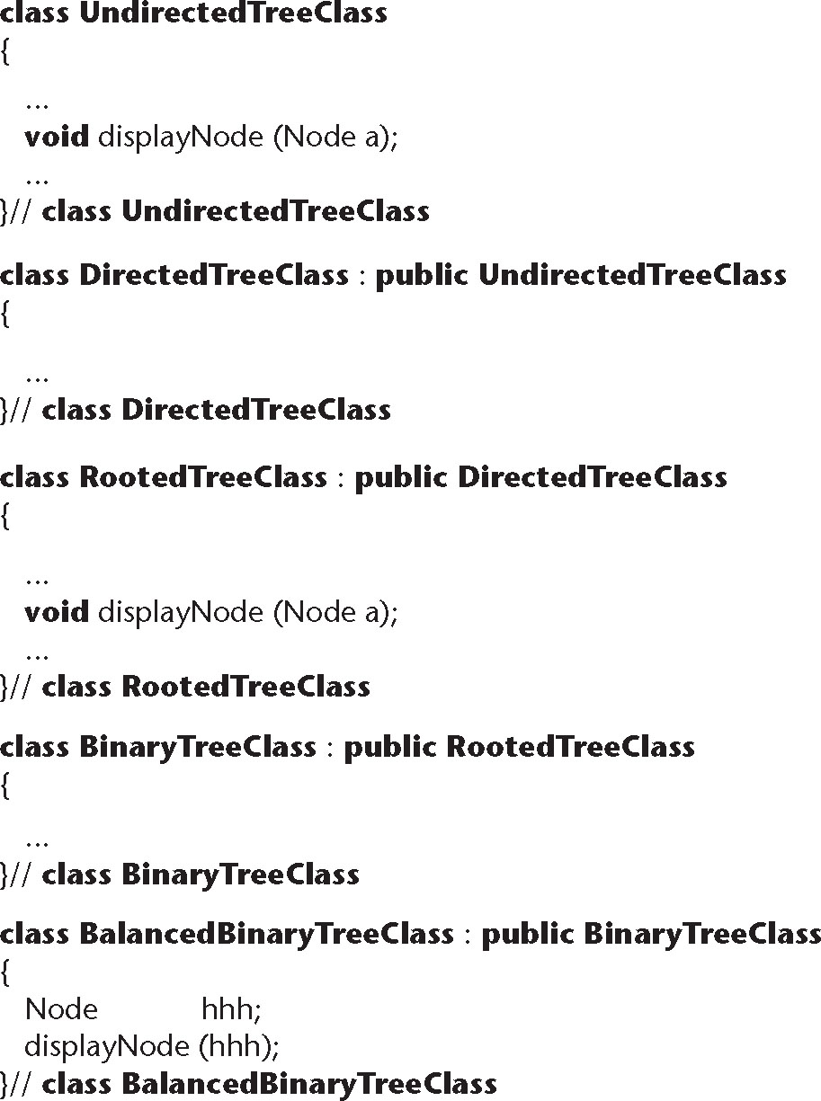
Size of the Inheritance Hierarchy
Figure 15.1

Slide 46
Size of Inheritance Hierarchy (contd)
To find out what displayNode does in BalancedBinaryTreeClass, we must scan the complete tree
  The inheritance tree may be spread over the entire product
  A far cry from “independent units”
Solution
  A CASE tool can flatten the inheritance tree

Slide 47
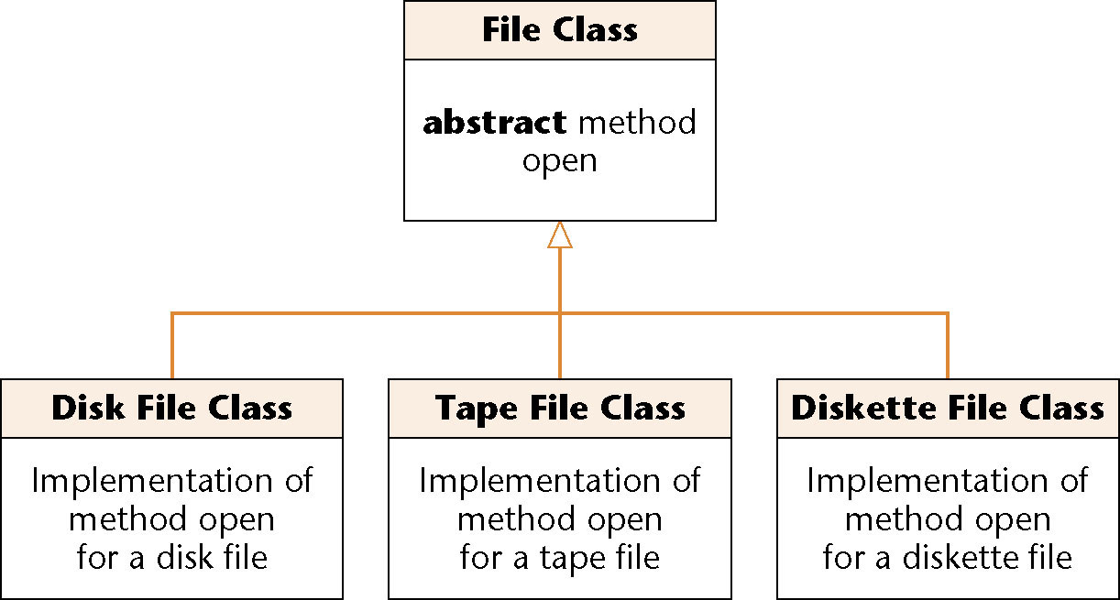
Polymorphism and Dynamic Binding
Figure 15.2
The product fails on the invocation myFile.open ()
Which version of open contains the fault?
  A CASE tool cannot help (static tool)
  We must trace

Slide 48
Polymorphism and Dynamic Binding (contd)
Polymorphism and dynamic binding can have
  A positive effect on development, but
  A negative effect on maintenance

Slide 49
Consequences of Inheritance
Create a new subclass via inheritance
The new subclass
  Does not affect any superclass, and
  Does not affect any other subclass
Modify this new subclass
  Again, no affect
Modify a superclass
  All descendent subclasses are affected
  “Fragile base class problem”

Slide 50
Consequences of Inheritance (contd)
Inheritance can have
  A positive effect on development, but
  A negative effect on maintenance

Slide 51
15.6 Postdelivery Maintenance versus Development Skills
The skills needed for maintenance include
  The ability to determine the cause of failure of a large product
    Also needed during integration and product testing
  The ability to function effectively without adequate documentation
    Documentation is rarely complete until delivery
  Skills in analysis, design, implementation, and testing
    All four activities are carried out during development

Slide 52
Postdelivery Maintenance vs. Development Skills (contd)
The skills needed for postdelivery maintenance are the same as those for the other workflows
Key Point
  Maintenance programmers must not merely be skilled in a broad variety of areas, they must be highly skilled in all those areas
  Specialization is impossible for the maintenance programmer
Postdelivery maintenance is the same as development, only more so

Slide 53
15.7 Reverse Engineering
When the only documentation for postdelivery maintenance is the code itself
  Start with the code
  Recreate the design
  Recreate the specifications (extremely hard)
  CASE tools can help (flowcharters, other visual aids)

Slide 54
Reverse Engineering (contd)
Reengineering
  Reverse engineering, followed by forward engineering
  Lower to higher to lower levels of abstraction
Restructuring
  Improving the product without changing its functionality
  Examples:
    Prettyprinting
    Structuring code
    Improving maintainability
    Restructuring (XP, agile processes)

Slide 55
Reverse Engineering (contd)
What if we have only the executable code?
  Treat the product as a black box
  Deduce the specifications from the behavior of the current product

Slide 56
15.8 Testing during Postdelivery Maintenance
Maintainers tend to view a product as a set of loosely related components
  They were not involved in the development of the product
Regression testing is essential
  Store test cases and their outcomes, modify as needed

Slide 57
15.9 CASE Tools for Postdelivery Maintenance
Configuration-control tools are needed
  Commercial tool
    CCC
  Open-source tool
    cvs
Reengineering tools
  Commercial tools
    IBM Rational Rose, Together
  Open-source tool
    Doxygen

Slide 58
CASE Tools for Postdelivery Maintenance (contd)
Defect-tracking tools
  Commercial tool
    IBM Rational ClearQuest
  Open-source tool
    Bugzilla

Slide 59
15.10 Metrics for Postdelivery Maintenance
The activities of postdelivery maintenance are essentially those of development
  Metrics for development workflows
Defect report metrics
  Defect classifications
  Defect status

Slide 60
15.11 Postdelivery Maintenance: The MSG Foundation Case Study
See Problems 15.11 through 15.15

Slide 61
15.12 Challenges of Postdelivery Maintenance
The chapter describes numerous challenges
The hardest challenge to solve
  Maintenance is harder than development, but
  Developers tend to look down maintainers, and
  Are frequently paid more

